Slide 1

Operation Find-the-Frog
Finding Frogs Based on Climate Clues and Data
Suman Anand – SXA230187
Sai Kumar – SXK220458
Prachi Rajendra Trivedi - PXT230010
Kaushil Madhubhai Mangaroliya – KMM210014
BUAN 6390.003 - Professor Brian Dean

Slide 2

Finding Frogs with Science
Analyze climate data to uncover hidden frog populations.
Identify key environmental factors influencing habitat suitability.
Develop a predictive model using machine learning techniques.
Transform raw climate data into ecological insights.
Support conservation efforts against climate change impacts.

Slide 3

Gathering Clues
Dataset
Comprehensive environmental factors collected
Understanding our dataset and the importance of features in locating frogs properly.
Important Features
Identifying variables that truly matter
Noise
In this phase, we analyze the dataset, focusing on key features that influence frog habitats, ensuring optimal model performance.
Eliminating irrelevant or misleading data
Challenge
Understanding which clues to prioritize

Slide 4
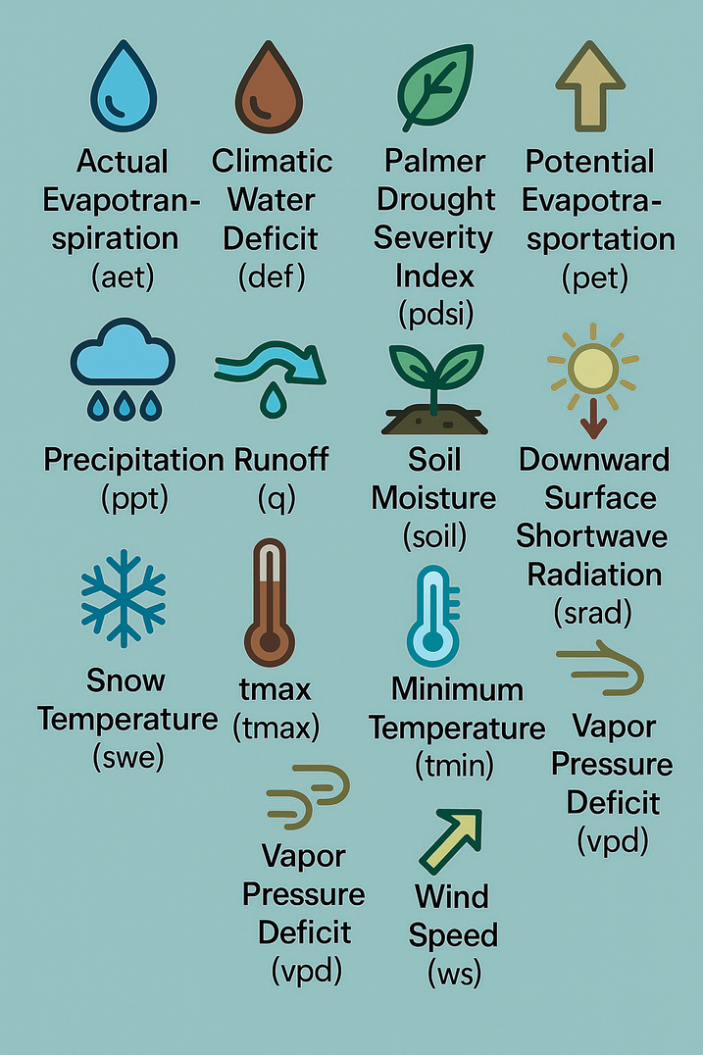
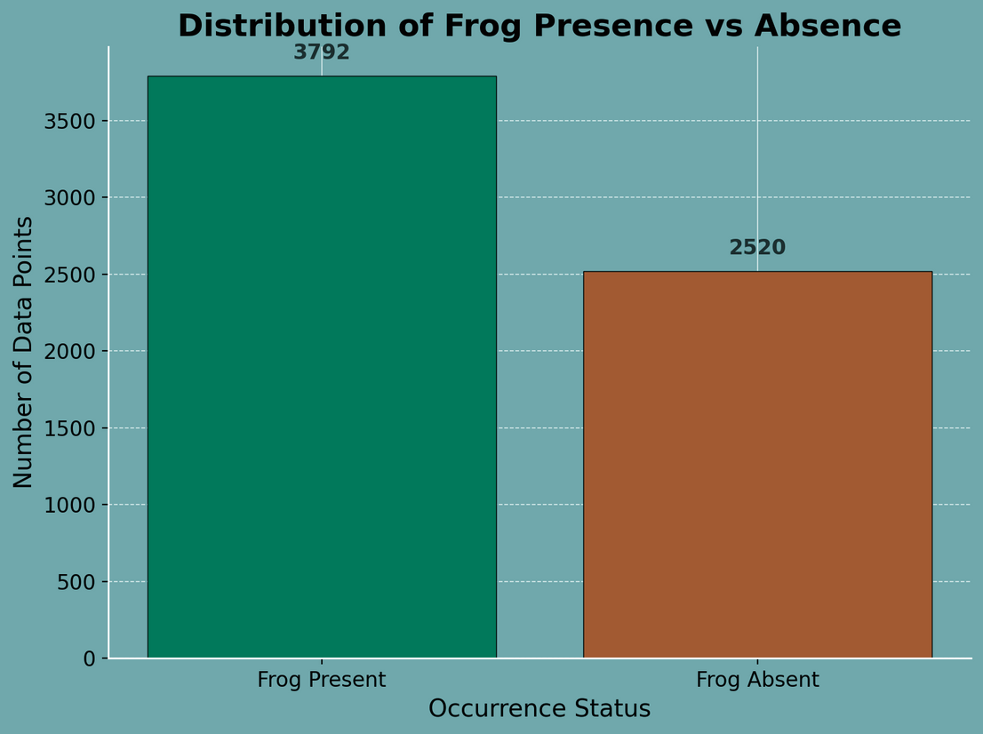
Exploring Clues

Slide 5
Building Our First Model - Logistic Regression
Challenges:
Poor handling of non-linear relationships.
Learning:
Need for a more powerful non-linear model.
Notes:
Just 2 features.
Minimal preprocessing applied.
Results:
F1 Score: ~65%

Slide 6
Feature Selection and Logistic Regression
New Strategy:
Selected top 10 climate-relevant features.
Result:
Accuracy: ~69%
Success:
Feature relevance improved signal-to-noise ratio.
Learning:
Feature engineering directly impacts model quality.

Slide 7
Support Vector Machine (SVM) with RBF kernel
Notes:
Scaling was critical due to distance-based nature.
Result:
Not the jump that we were expecting.
Accuracy: 71%
Limitation:
Poor performance compared to tree-based models.

Slide 8
Neural Network Attempt
Notes:
Implemented SMOTE + basic feedforward neural network using Keras.
Architecture:
Input Layer → 4 Hidden Layers (ReLU) → Output Layer (Sigmoid)
Result:
Overfit quickly without heavy regularization.
Accuracy plateaued around ~74%.
Challenge:
Required larger dataset and tuning for better generalization.

Slide 9

Sharpening Our Senses
Focusing on feature selection and systematic testing for improved accuracy in our model.
Now, we emphasize on feature selection to enhance model performance, ensuring that every variable contributes significantly to our findings.

Slide 10
Feature Selection + New Features (Interaction Terms)
Strategy:
Added polynomial interaction terms between selected features with SMOTE for class imbalance problem.
Models Tried: Logistic Regression and Random Forest
Results:
Accuracy: 79% (Random Forest)
Insights:
Interaction features boosted raw accuracy but did not significantly improve F1 Score.
Learning:
Adding complexity without addressing model flexibility has limited benefit.

Slide 11

The Breakthrough Moment
Random Forest with 7 Features + Hyperparameter Tuning

Slide 12
Random Forest with 7 Features + Hyperparameter Tuning
Enhancements:
7 carefully selected features.
Tuned n_estimators=100, max_depth=50
Result:
Training Accuracy: 97%
External F1 Score: 82.44%
Success:
Random Forest captured non-linear interactions and feature importance effectively.
Learning:
Tree-based ensemble methods are robust for environmental prediction tasks.

Slide 13
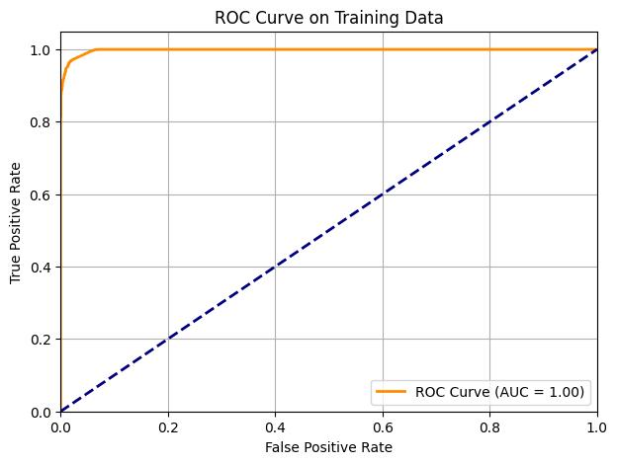
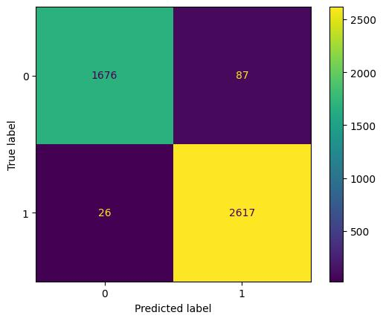
ROC Curve and Confusion Matrix

Slide 14
Model Performance Comparison
Model | Accuracy
Logistic Regression + Top 10 Features | 69%
Support Vector Machine (SVM) | 71%
Neural Network | 74%
Random Forest + Interactions | 79%
Random Forest with 7 Features + Hyperparameter Tuning | 97% Test F1-Score: 82.44%

Slide 15
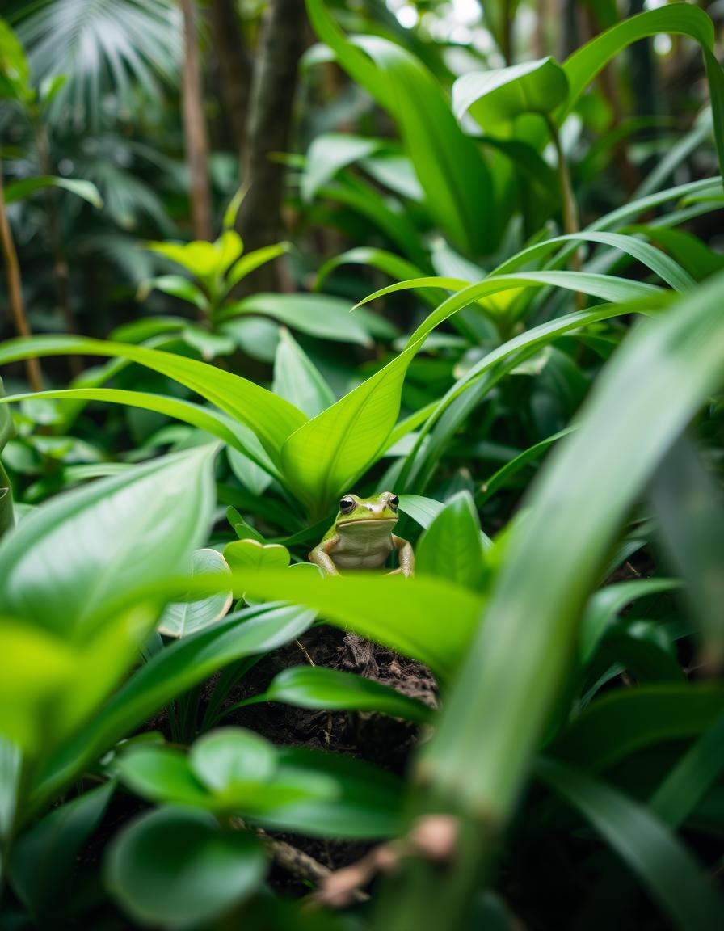
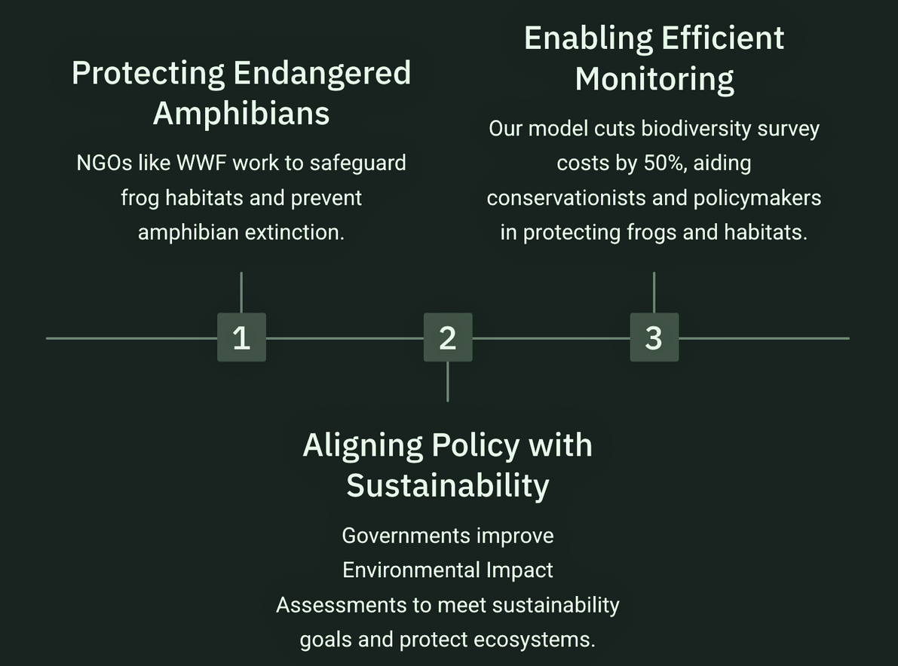
Real-World Applications: Conservation & Policy

Slide 16
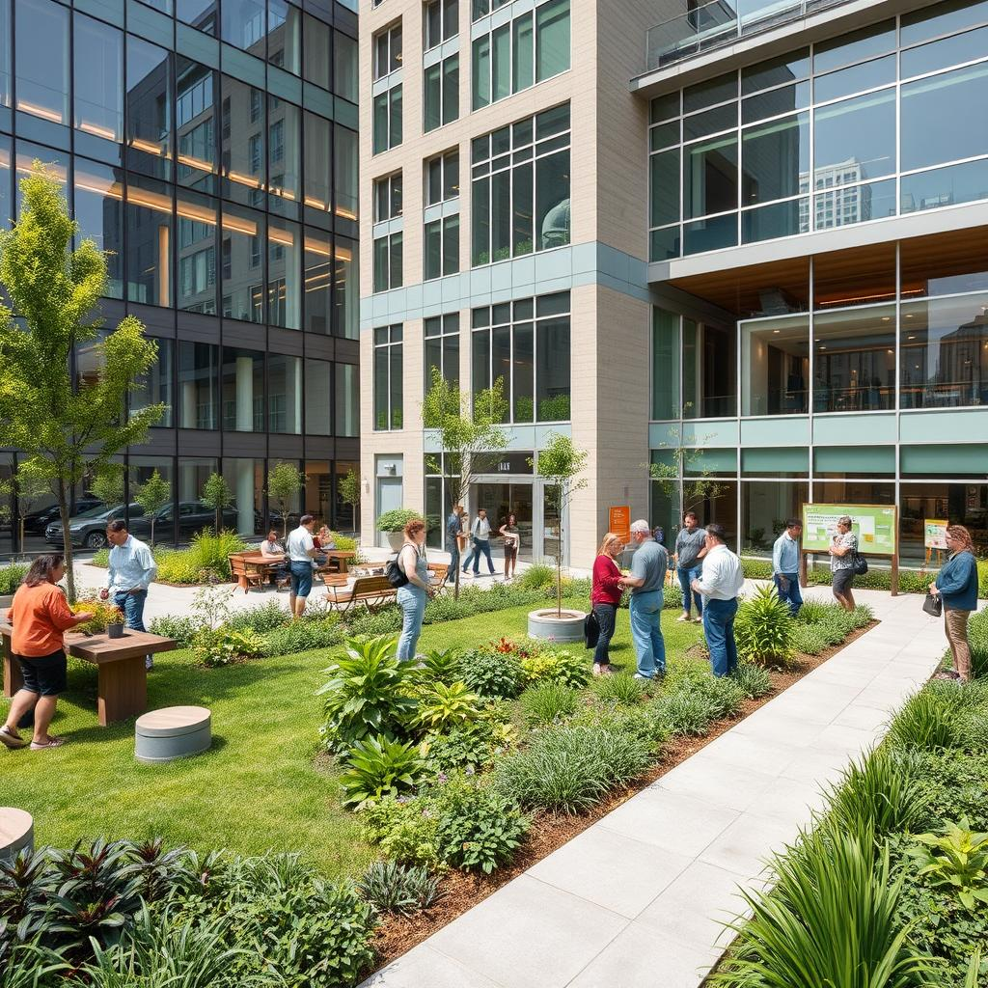
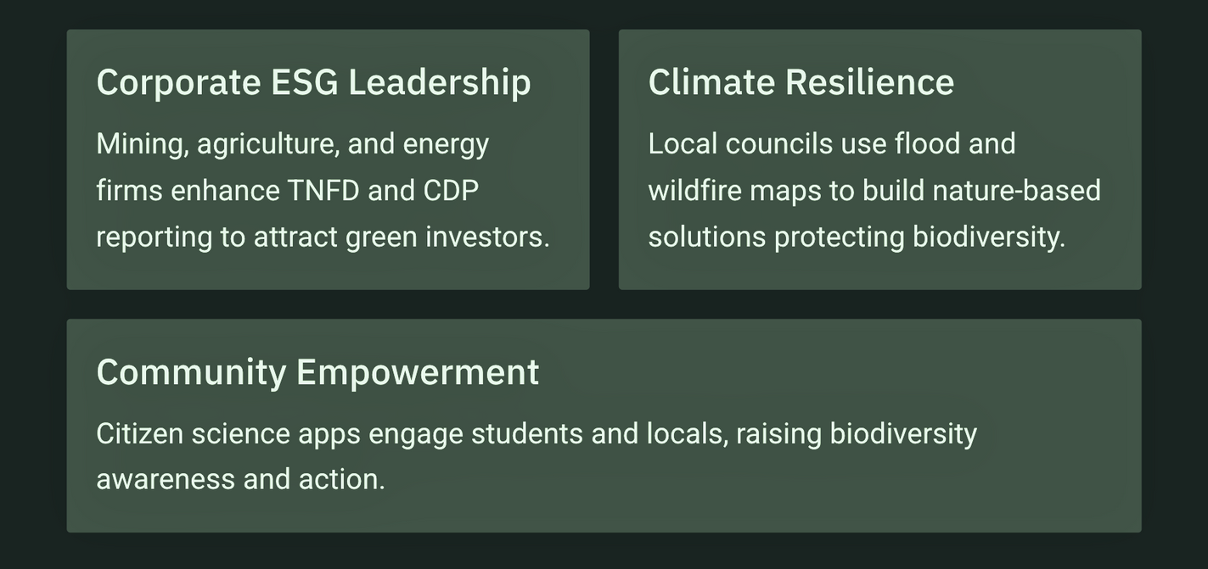
Corporate & Community Impact

Slide 17

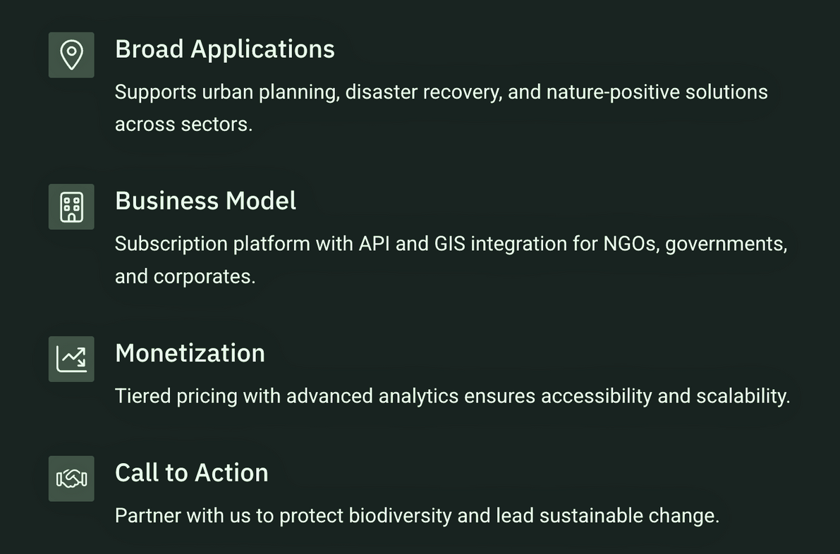
Scalable Impact and Business Value

Slide 18
Future Enhancements
Enhance Features:
Add seasonal and lagged climate variables to capture temporal patterns.
Generalization and Real-World Testing:
Validate models across different regions and future time periods.
An App - FrogSight:
Make the App available for citizen scientists to capture data points for Global Implementation.

Slide 19
Reflections on Our Adventure
Throughout this journey, we learned invaluable lessons about
Data accuracy
Model selection
Significance of features
Problem-solving skills
Team coordination and colaboration
Gained technical proficiency in Python and Machine learning models along with domain knowledge in biodiversity conservation.
Each step brought us closer to our goal of finding frogs!

Slide 20
Thank You, Adventurers!
This journey unveiled how data and collaboration can ignite hope for biodiversity!
Notes:
We appreciate your attention and enthusiasm for our journey into machine learning. Together, we can explore new dimensions in technology and biology, making a difference in frog conservation!

